Slide 1
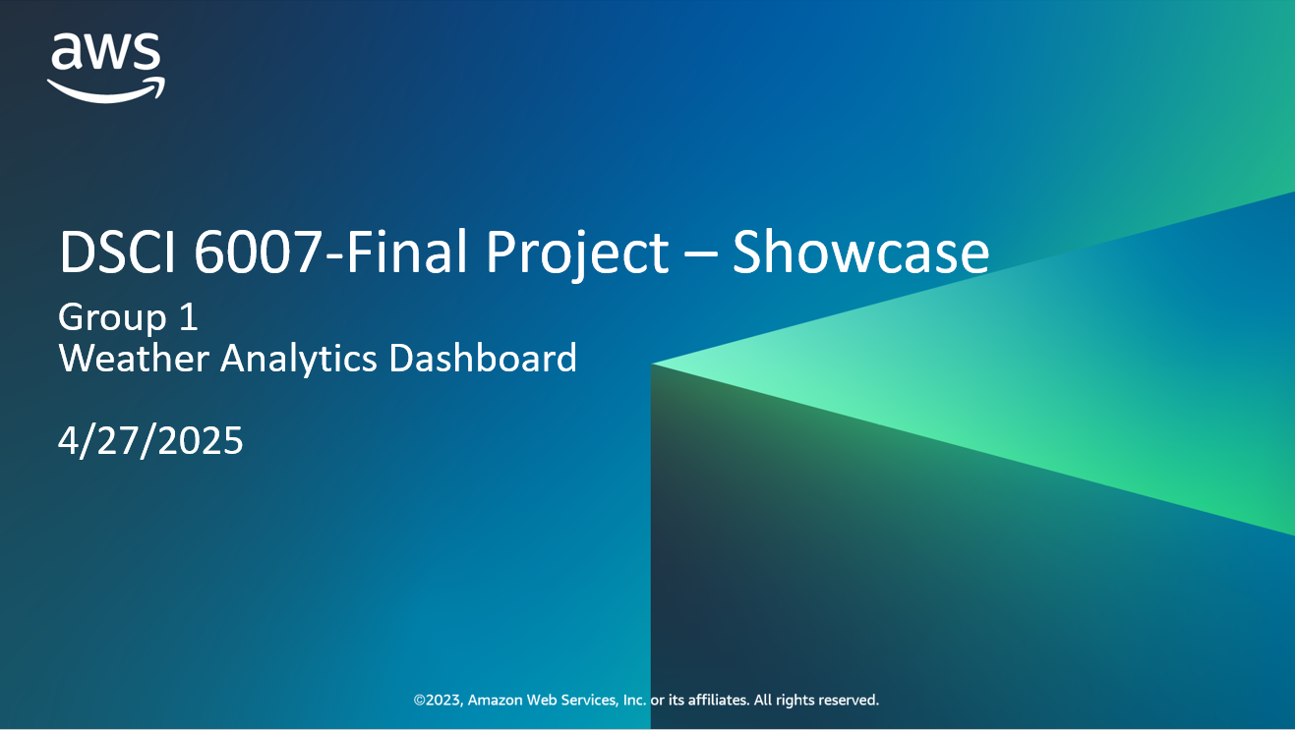

Slide 2
Meet the Team
Aldric Pinto
Tanak Patel
Trevor Hitchcock

Slide 3
Business scenario overview
Logistics companies face challenges due to unpredictable weather conditions
Impacts routing efficiency and increase operational costs
To address this, a solution must:
Provide real-time and historical weather data across key U.S. cities
Update automatically on a daily basis, include hourly data
Be interactive and user-friendly to allow logistics professionals to quickly interpret trends
Include scalable, low-maintenance architecture

Slide 4
Solution overview
A weather analytics dashboard powered by an automated AWS-based pipeline. It collects, processes, and visualizes weather data from the Open-Meteo API for multiple U.S. cities, allowing logistics professionals to make data-driven operational decisions.
Design Considerations
Automation: Daily updates using AWS Glue jobs and scheduled API ingestion
Scalability: Serverless architecture with Amazon S3, Athena, and Glue
Flexibility: Supports hourly and daily granularity for versatile analysis
Usability: Interactive Power BI dashboard with filters for city and time range
Reliability: Robust data cataloging and query capability via Glue + Athena
Use Cases
Route planning based on weather forecasts
Adjusting delivery times during high UV or precipitation levels
Monitoring historical climate trends in target service areas
Identifying day/night patterns to improve fleet scheduling

Slide 5
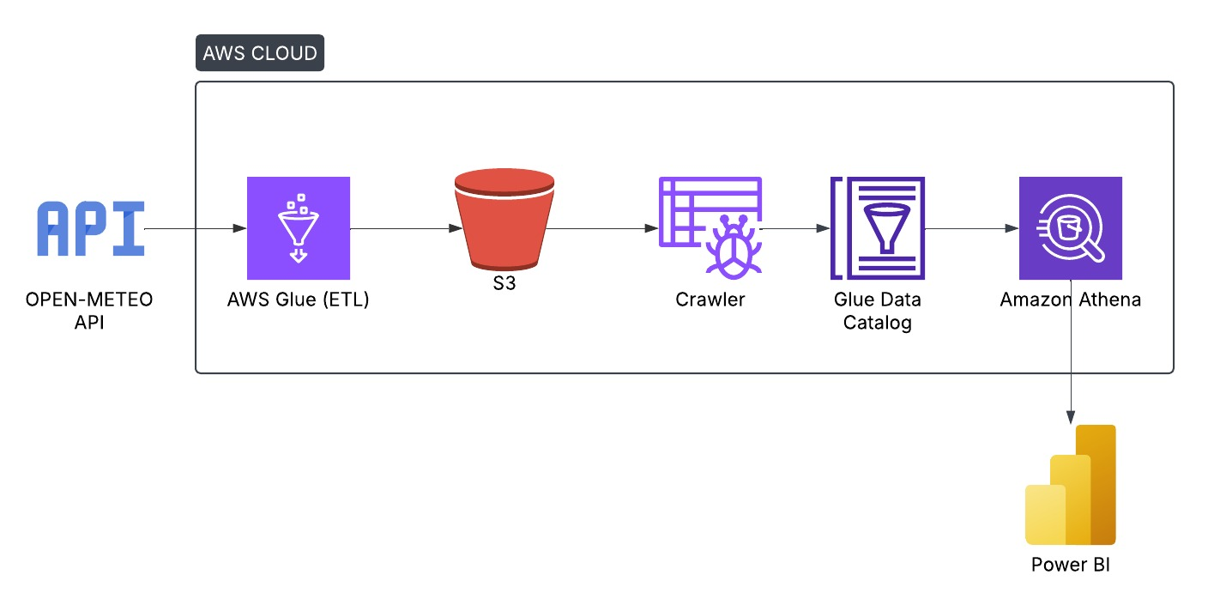
Architecture diagram of the solution
<Put your diagram here. Refer to the slide notes for more information.>

Slide 6
Lessons learned
Challenges Overcome:
Dealing with missing or delayed data, which affected chart accuracy. We added better data checks to address this.
Helpful Resources:
Open-Meteo
AWS docs for Glue & Athena
New Skills Used:
AWS Glue, Athena, S3
Power BI integration
Next Steps:
Add real-time data with AWS Kinesis
Use SageMaker for predictions
Improve data quality checks
Optimize system for scale and cost

Slide 7
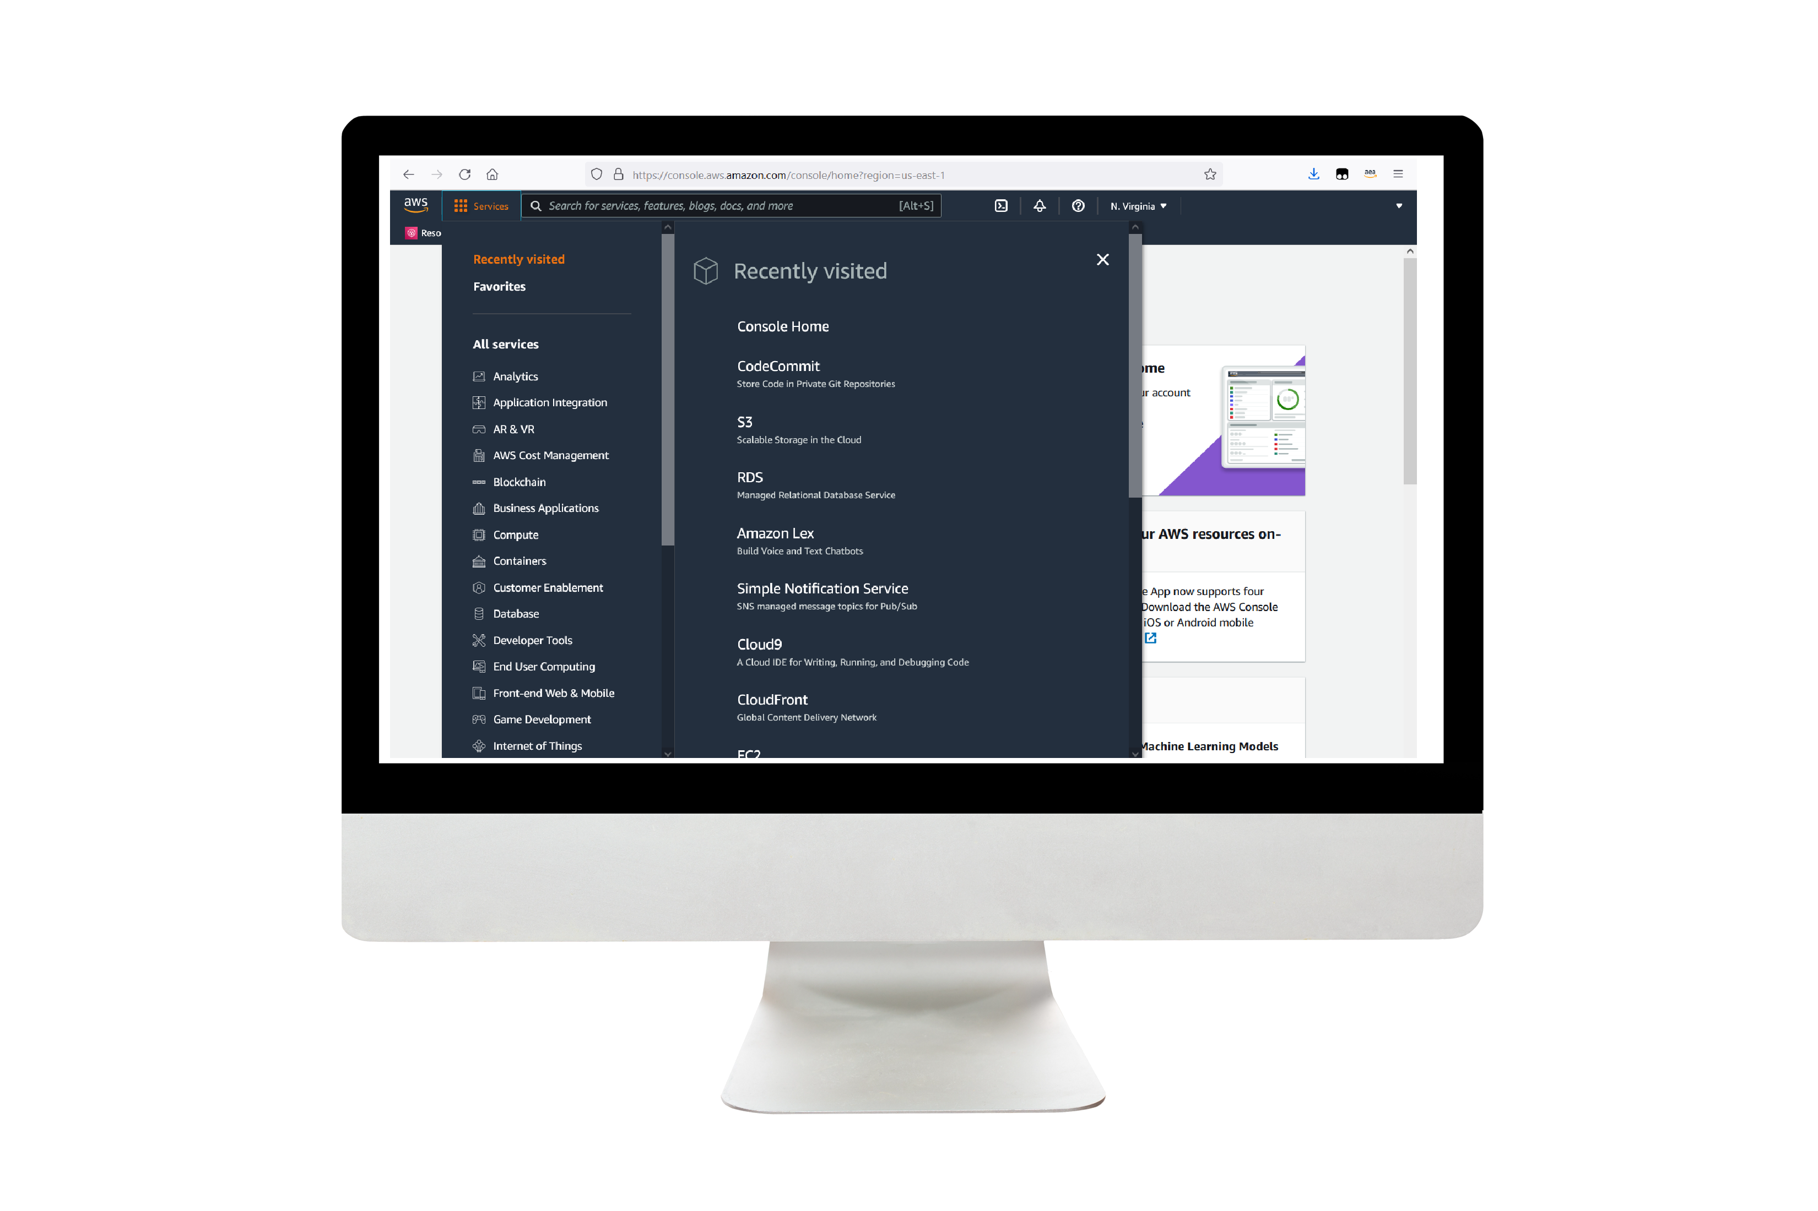
Demo
Include the link to the demo materials.
Notes:
For the demo, guide the audience through the two to three most important benefits of the solution and how it addresses the requirements.
Your demo materials can be screen captures, recordings, a link to your final solution, and/or a link to AWS console.

Slide 8
Thank you
GitHub

